Slide 1
New Methods for the
Visualization of Incommensurately
(and Commensurately)
Modulated Structures
Robert M. Hanson
St. Olaf College, Northfield, MN
http://www.stolaf.edu/people/hansonr
MS-81 Pushing the Boundaries of Aperiodic
Magnetic & Crystal Structure Solution
23rd Congress of the International Union of Crystallography
Montreal, Canada
Aug 11, 2014

Slide 2
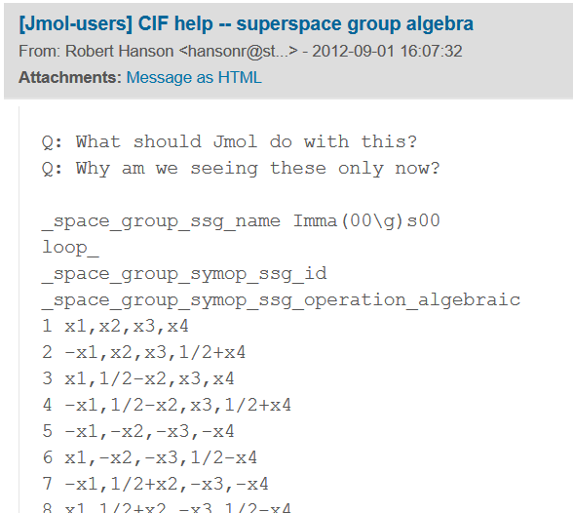
Development and Validation

Slide 3
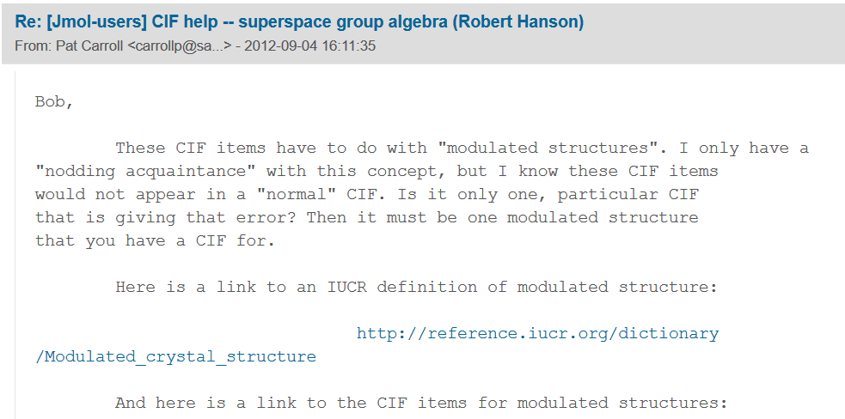
Development and Validation

Slide 4
Development and Validation
Modulated crystal structure
Structure cristalline modulée (Fr.), Struttura cristallina modulata (It), 変調構造 (Ja)
Definition
A modulated crystal structure is a density (or atom arrangement) that may be obtained from a density (or atom arrangement) with space-group symmetry by a finite density change (or finite displacement of each atom, respectively) that is (quasi)periodic. A function or a displacement field is periodic if it is invariant under a lattice of translations. Then its Fourier transform consists of δ-peaks on a reciprocal lattice that spans the space and is nowhere dense. A quasiperiodic function has a Fourier transform consisting of δ-peaks on a vector module of finite rank. This means that the peaks may be indexed with integers using a finite number of basis vectors. If the modulation consists of deviations from the basic structure in the positions, the modulation is displacive (displacive modulation, see Figure.). When the probability distribution deviates from that in the basic structure the modulation is occupational.

Slide 5
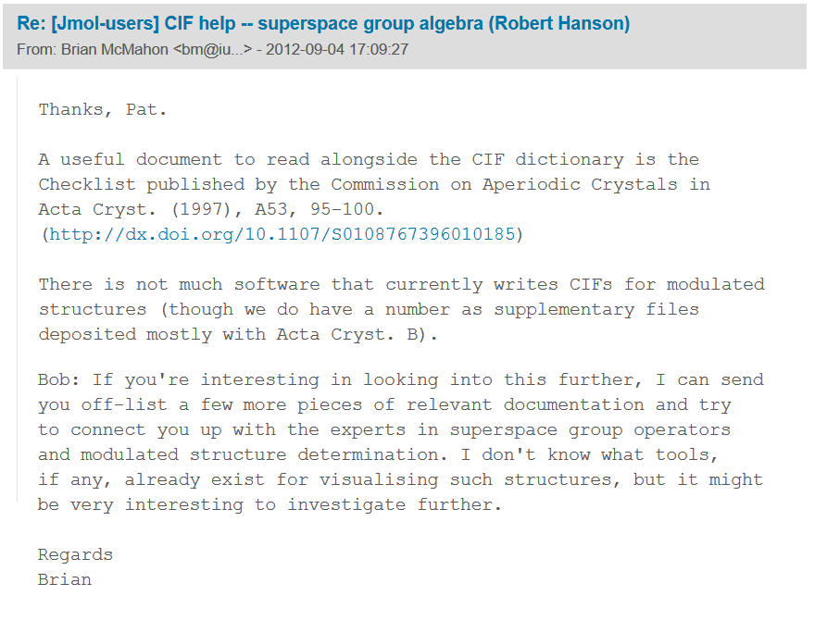
Development and Validation

Slide 6
Development and Validation

Slide 7
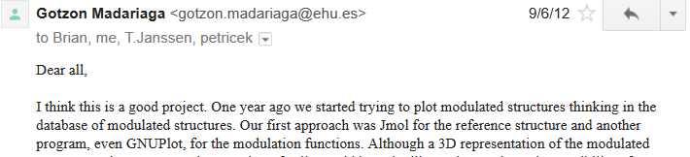
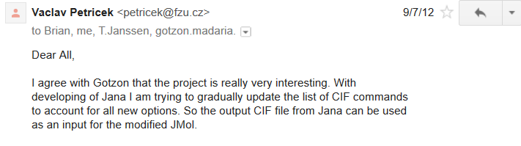
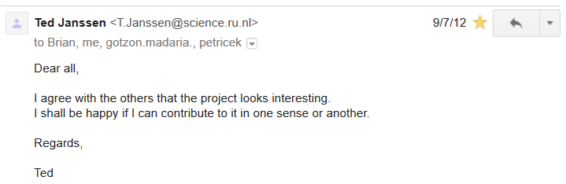
Development and Validation

Slide 8
Development and Validation
Bob’s path to modulated structure visualization in Jmol
Sept, 2012 – first introduction to superspace groups
(but busy with Java-to-JavaScript conversion)
June, 2013 – sabbatical begins, return to problem
Aug, 2013 – d=1 displacement, occupancy, anisotropy
Dec. 2013 – d=2; composite structures
Jan. 2014 -- commensurate structures

Slide 9
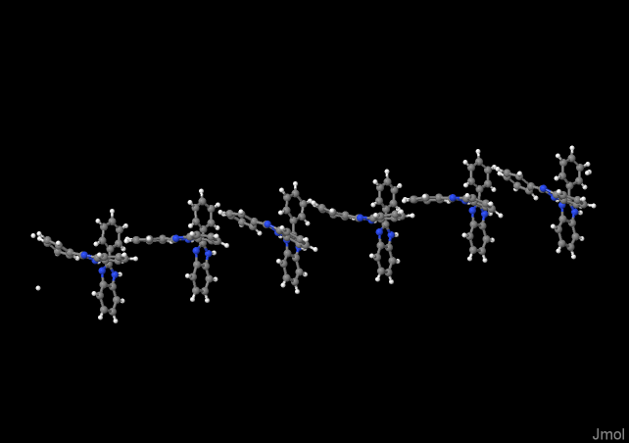
Conceptualizing Modulation
Modulations are periodic perturbations of a “perfect” crystal that are not the wavelength of the lattice.

Slide 10
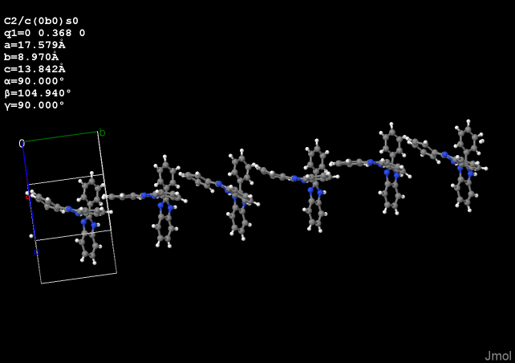
Conceptualizing Modulation
Modulations are periodic perturbations of a “perfect” crystal that are not the wavelength of the lattice.

Slide 11
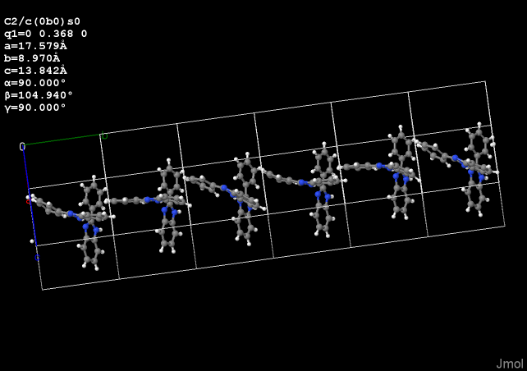
Conceptualizing Modulation
Modulations are periodic perturbations of a “perfect” crystal that are not the wavelength of the lattice.

Slide 12
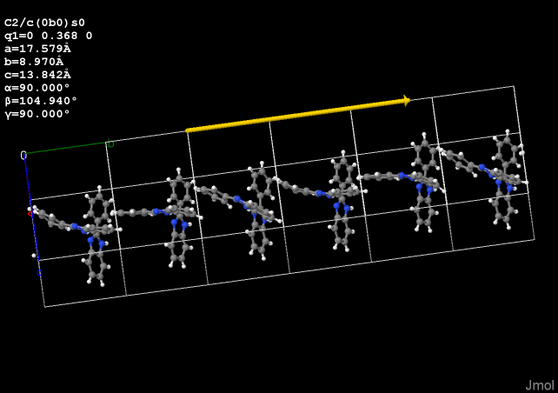
Conceptualizing Modulation
Modulations are periodic perturbations of a “perfect” crystal that are not the wavelength of the lattice.

Slide 13
Conceptualizing Modulation
Modulations, being periodic themselves, can be represented as wave functions operating in reciprocal space.
q = σ1 a1* + σ2 a2* + σ3 a3*

Slide 14
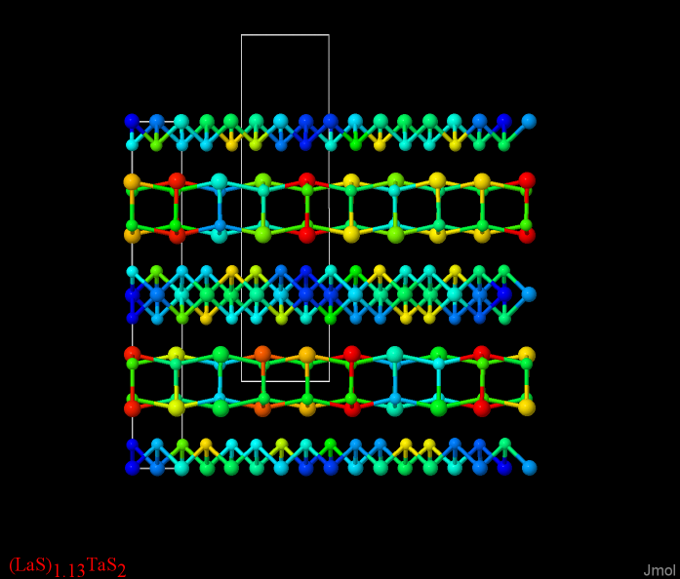
Conceptualizing Modulation
There can be more than one cell wave vector.
q1 = σ11 a1* + σ12 a2* + σ13 a3*
q2 = σ21 a1* + σ22 a2* + σ23 a3*

Slide 15
Conceptualizing Modulation
There can be more than one cell wave vector.
q1 = σ11 a1* + σ12 a2* + σ13 a3*
q2 = σ21 a1* + σ22 a2* + σ23 a3*
Jmol can handle up to nine
independent cell wave vectors and
can allow manipulation of up to
three.

Slide 16
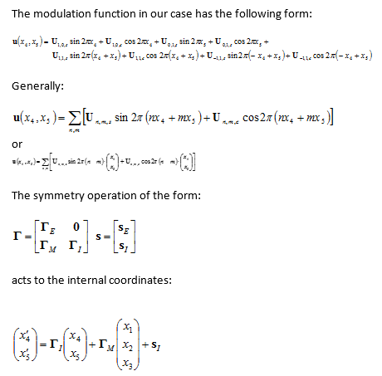
The Challenge
So my challenge was twofold:
Do the math right.
2013.08.19, Vaclav Petricek

Slide 17
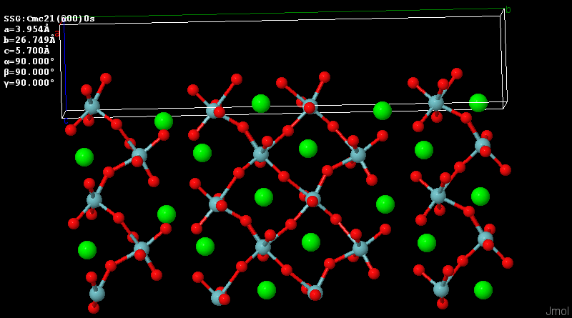
The Challenge
So my challenge was twofold:
Do the math right.
Come up with valuable and accessible means of visualizing 4+ dimensions of information (ultimately) in two dimensions.

Slide 18
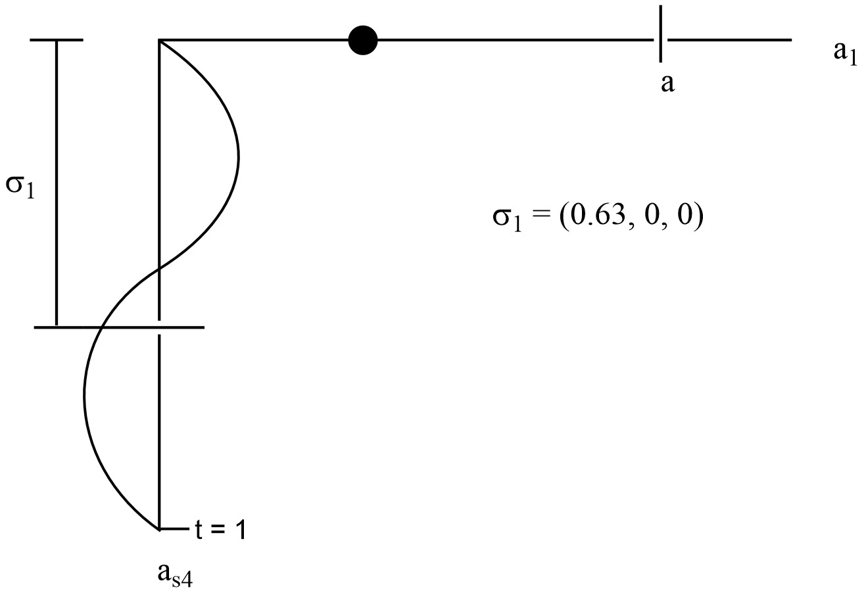
Conceptualizing Modulation
An elegant representation of modulation is via superspace groups, where we have augmented real 3d space by n additional orthogonal dimensions.
This is not easily represented on a 2D slide!
Sander van Smaalen
Incommensurate Crystallography
IUCr/Oxford Science, 2007

Slide 19
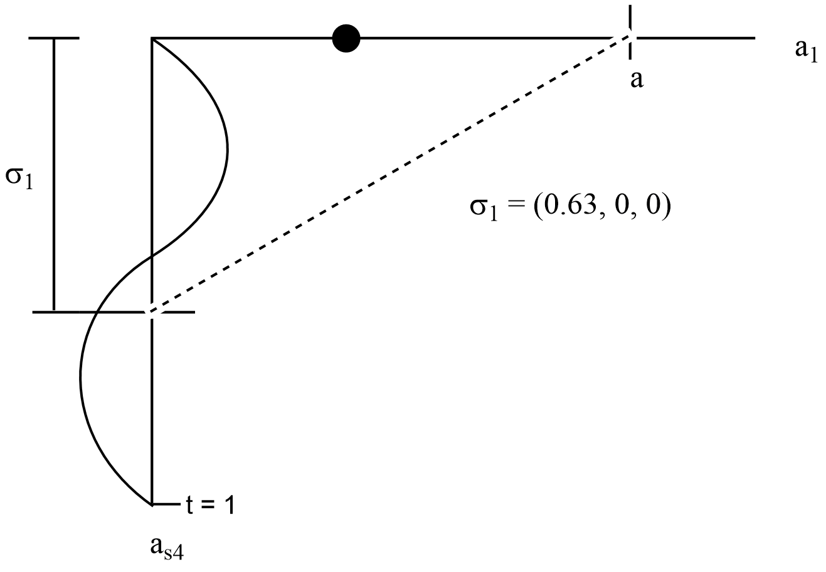
Conceptualizing Modulation
An elegant representation of modulation is via superspace groups, where we have augmented real 3d space by n additional orthogonal dimensions.
σ gives us the relationship between points in real space and their associated modulation magnitudes.

Slide 20
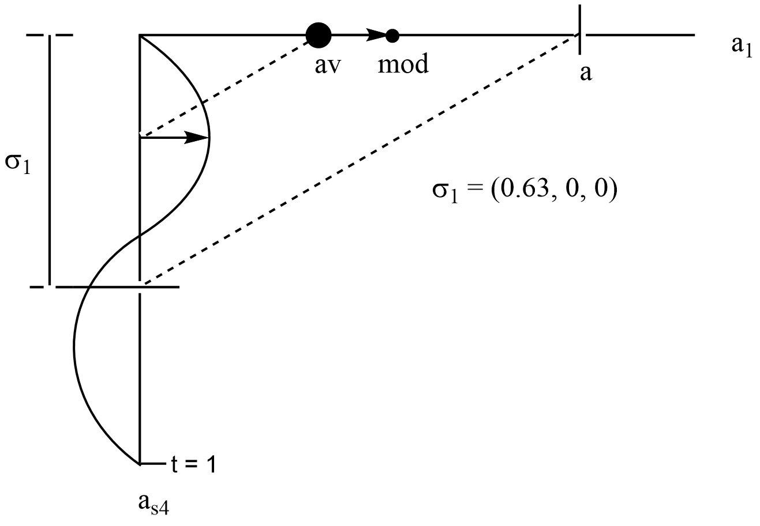
Conceptualizing Modulation
An elegant representation of modulation is via superspace groups, where we have augmented real 3d space by n additional orthogonal dimensions.
Projecting atoms onto these additional dimensions allows us to “read” the modulation and apply it.

Slide 21
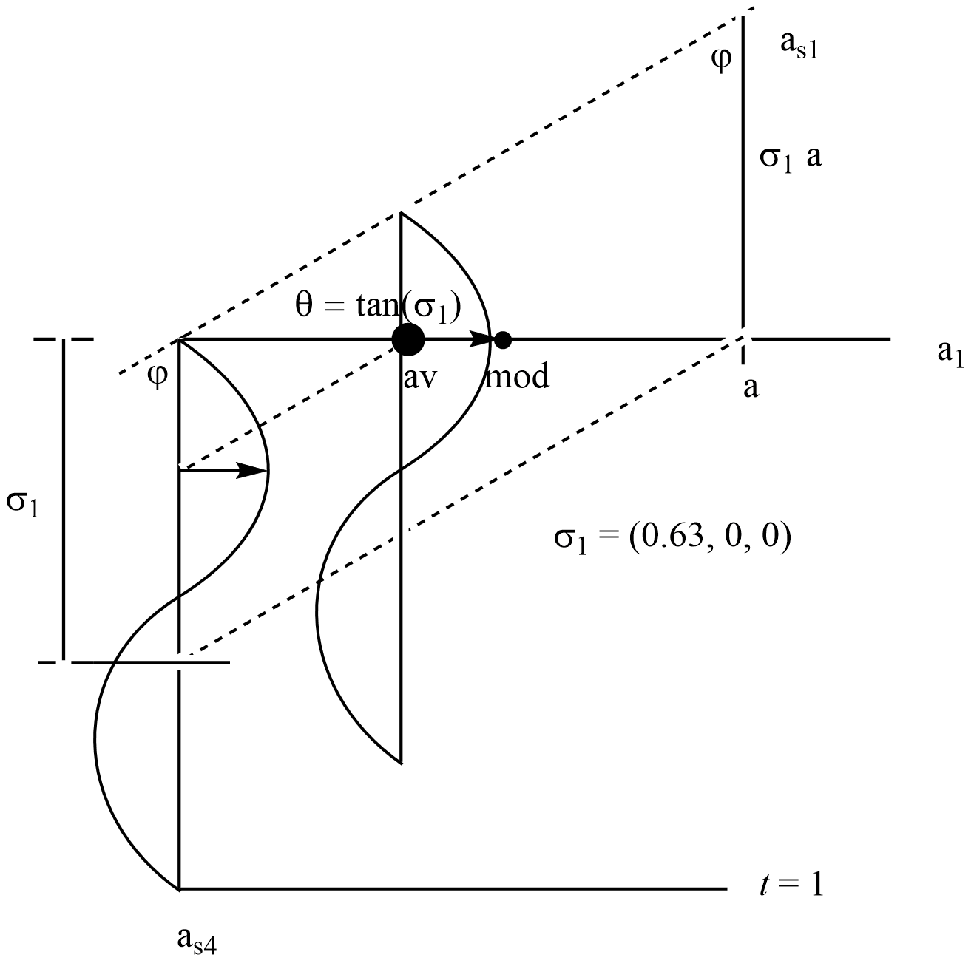
Conceptualizing Modulation
An elegant representation of modulation is via superspace groups, where we have augmented real 3d space by n additional orthogonal dimensions.
One can think of a atom as being
a 3d+n-dimensional string that
is being projected into
real space.

Slide 22
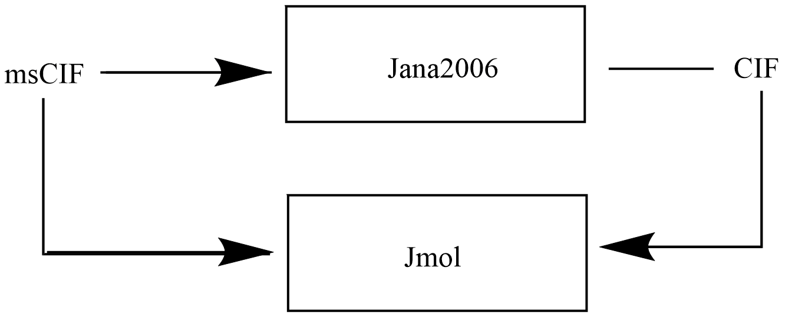
Development and Validation
All tests validated using direct comparison with Jana2006
2013.08.06

Slide 23
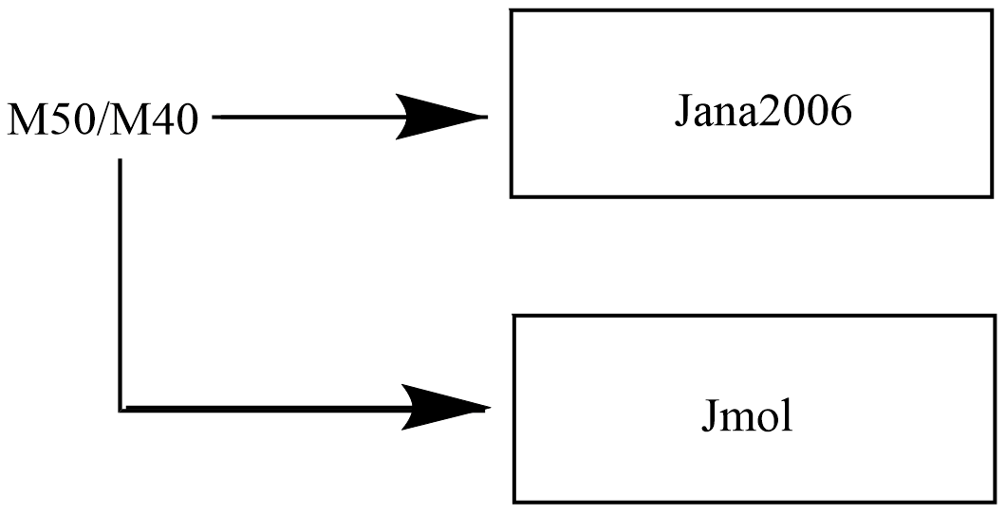
Development and Validation
All tests validated using direct comparison with Jana2006
2013.08.06

Slide 24
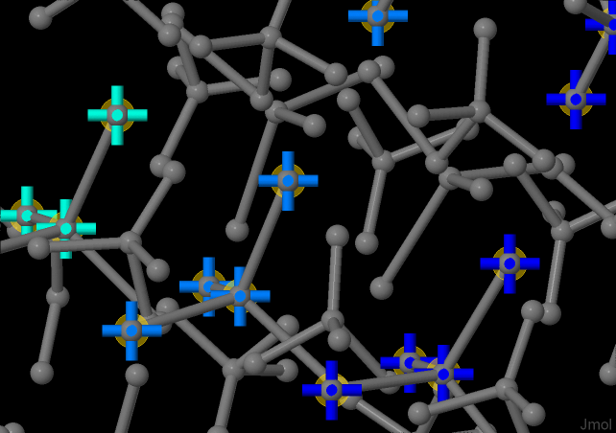
Development and Validation - displacement
All tests validated using direct comparison with Jana2006
2013.08.06

Slide 25
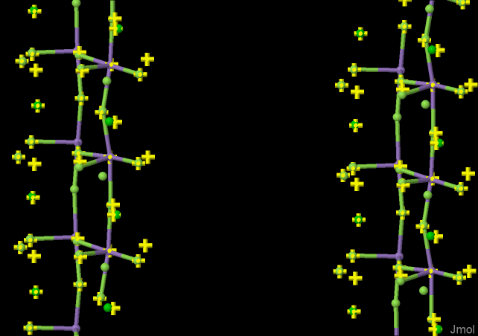
Development and Validation - displacement
2013.08.06 (Jmol balls; Jana2006 crosses; errors in displacement)

Slide 26
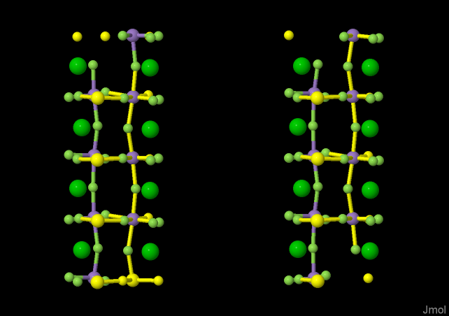
Development and Validation - displacement
2013.08.07 – d=1 fourier displacements (balls Jmol; sticks Jana2006)

Slide 27
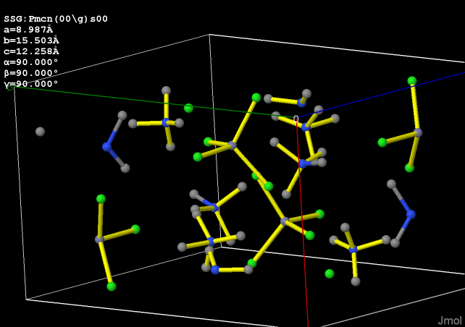
Development and Validation - displacement
2013.08.07 – d=1 fourier displacements (balls Jmol; sticks Jana2006)

Slide 28
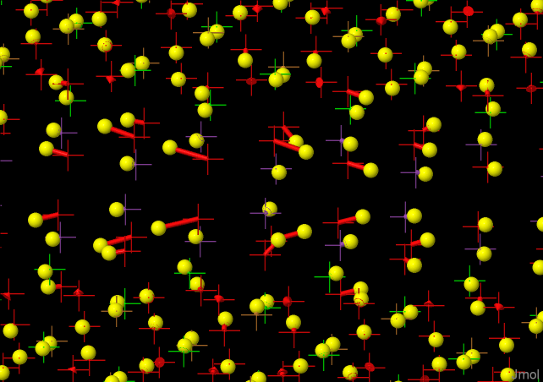
Development and Validation - sawtooth
2013.08.08 – d=1 sawtooth displacements (cross average; line mod; ball Jana2006)

Slide 29
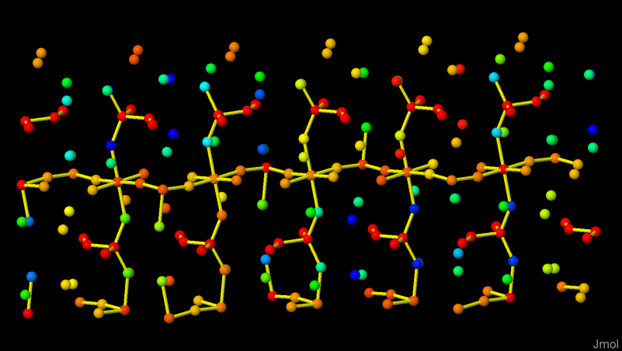
Development and Validation - occupancy
2013.08.08 – d=1 crenel-based occupancy (Jmol balls, Jana2006 sticks)

Slide 30
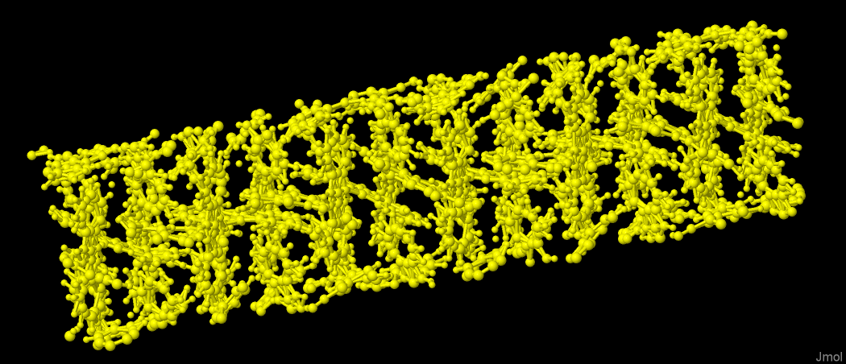
Development and Validation - occupancy
2013.08.08 – d=1 (Jana2006 plot of structure)

Slide 31
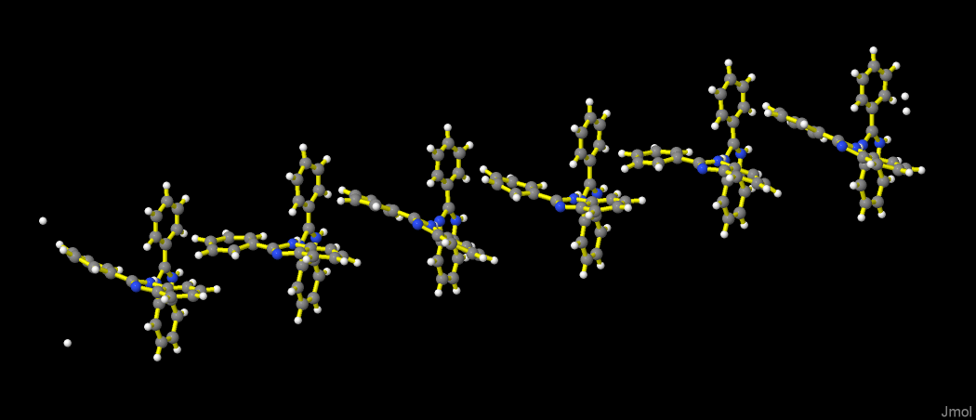
Development and Validation - occupancy
2013.08.08 – d=1 (Jmol reading Jana2006 M50 file; symop 3 (lines Jana; balls Jmol)

Slide 32
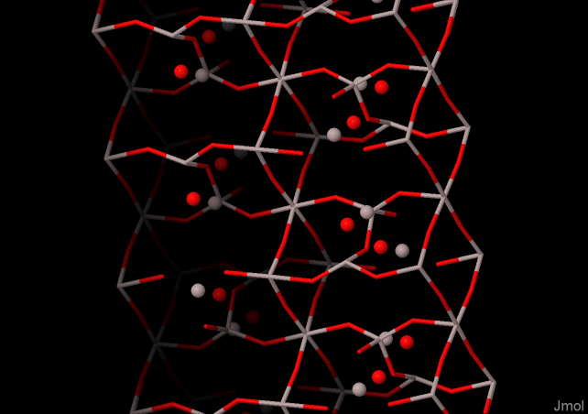
Development and Validation - occupancy
2013.08.08 – d=1 Crenel structure highlighting atoms removed by the function

Slide 33
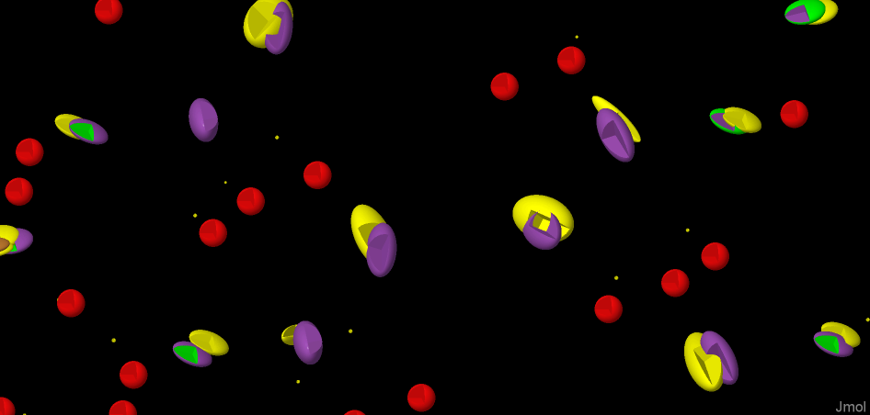
Development and Validation - anisotropy
2013.08.12 – d=1 anisotropic parameters/fourier (Jana2006 yellow; Jmol average)

Slide 34
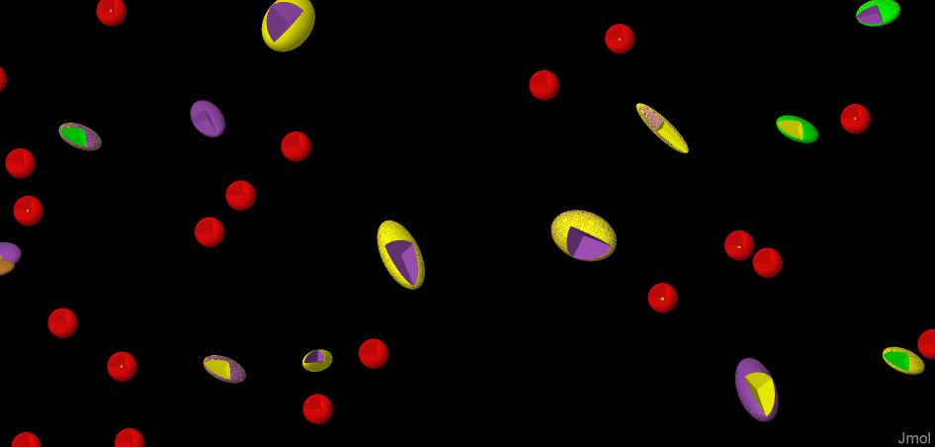
Development and Validation - anisotropy
2013.08.12 – d=1 anisotropic parameters/fourier (Jana2006 yellow; Jmol colored)

Slide 35
Development and Validation - composites
2013.12 – two-component incommensurate misfit compound colored by modulation

Slide 36
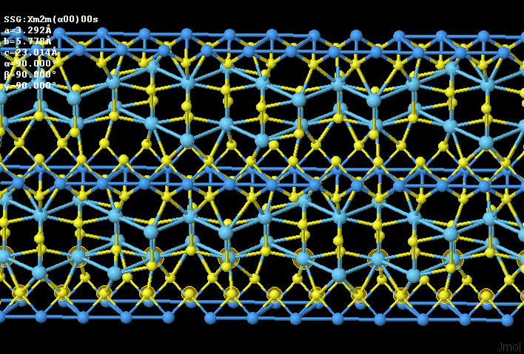
Development and Validation - composites
2013.12.30 – LaS1.13-TaS2 misfit layer compound

Slide 37
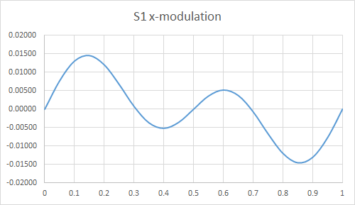
Development and Validation - functions
2013.12.30 – LaS1.13-TaS2 misfit layer compound

Slide 38
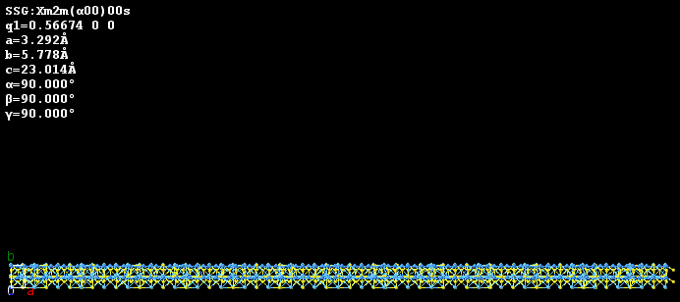
Development and Validation - functions
2013.12.30 – LaS1.13-TaS2 misfit layer compound; load “” {50 1 1}

Slide 39
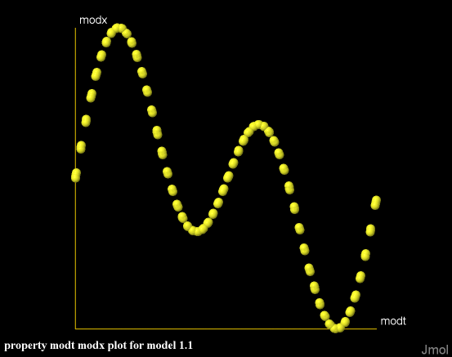
Development and Validation - functions
select S1; plot properties modt modx
2013.12.30 – LaS1.13-TaS2 misfit layer compound

Slide 40
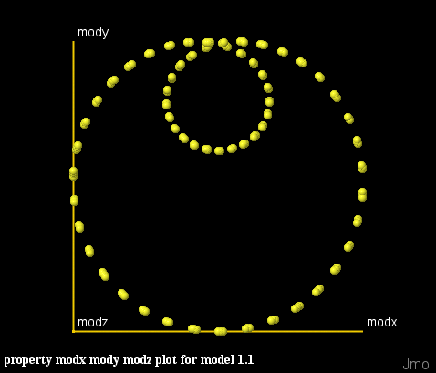
Development and Validation - functions
select S1; plot properties modx mody modz
2013.12.30 – LaS1.13-TaS2 misfit layer compound

Slide 41
Development and Validation - distances
2013.12.30 – LaS1.13-TaS2 misfit layer compound

Slide 42
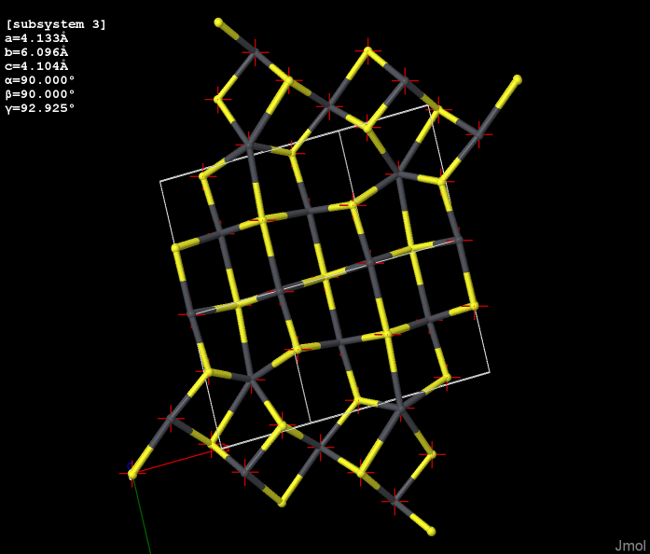
Development and Validation - composites
2014.01.10 composite subsystems (lilianite)

Slide 43
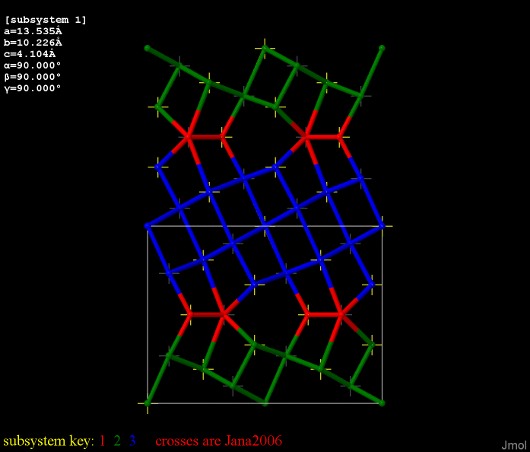
Development and Validation - composites
2014.01.10 composite subsystems (lilianite; colored by subsystem)

Slide 44
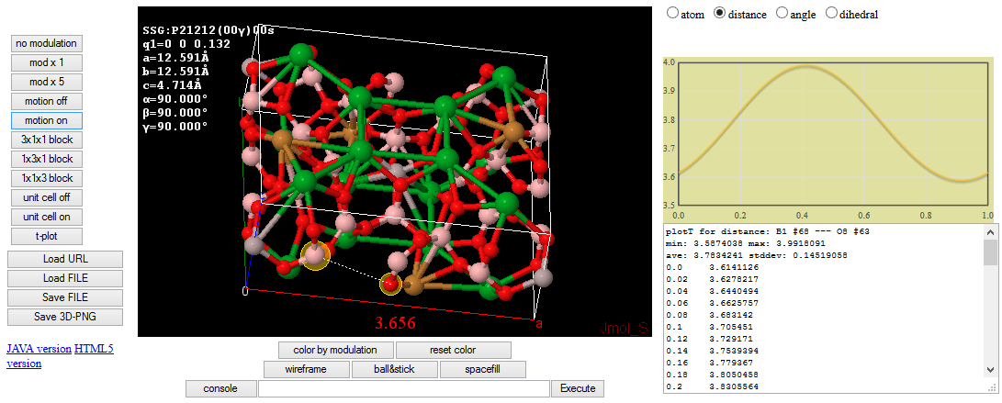
Implementation – Bilbao Cryst. Database
2014.05.30 – http://b-incstrdb.ehu.es/incstrdb

Slide 45
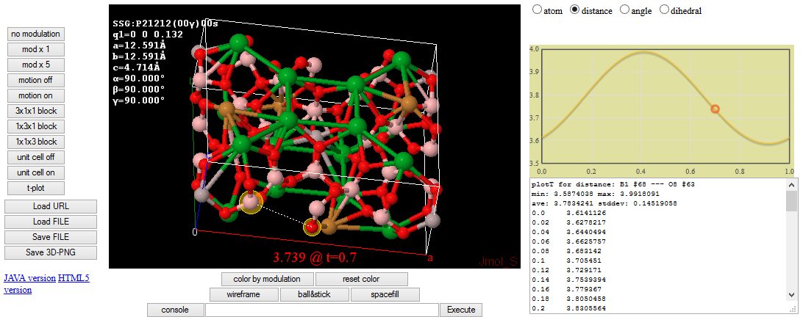
Implementation – Bilbao Cryst. Database
2014.05.30 – http://b-incstrdb.ehu.es/incstrdb

Slide 46
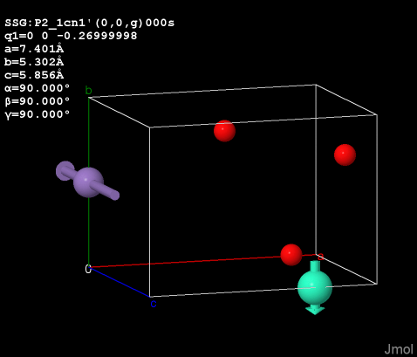
Current Work – Incom. Magnetic Structures
2014.08.09

Slide 47
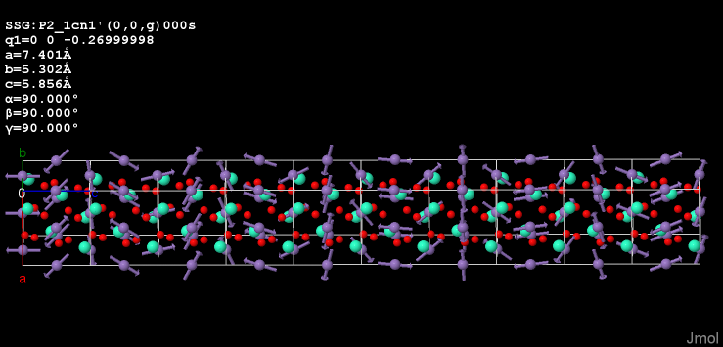
Current Work – Incom. Magnetic Structures
2014.08.09

Slide 48
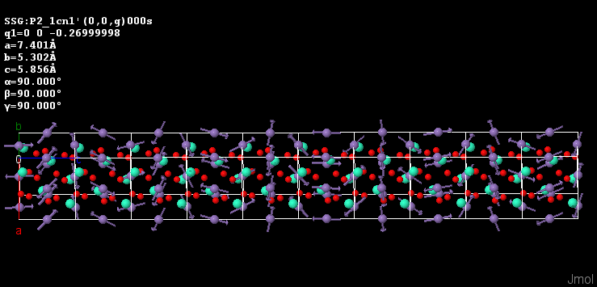
Current Work – Incom. Magnetic Structures
2014.08.09

Slide 49
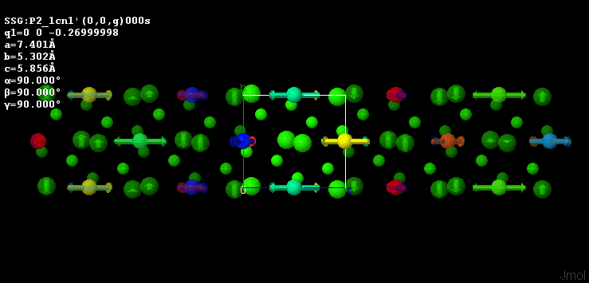
Current Work – Incom. Magnetic Structures
2014.08.09 – http://b-incstrdb.ehu.es/incstrdb

Slide 50
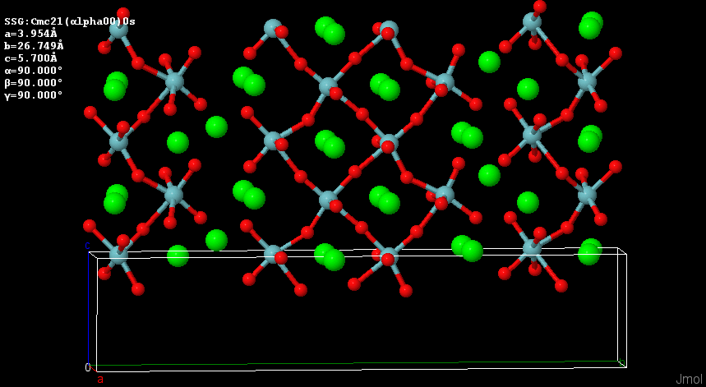
Future Plans
Legendre polynomials
X-harmonics
You tell me!

Slide 51
Getting Started with Jmol
https://sourceforge.net/projects/jmol/files/
Start Jmol.jar
Drag-drop a CIF or M50 file into it
Open File…Console
Enter
load “” {1 1 1}
or
help

Slide 52
Acknowledgments
Pat Carroll, Brian McMahon,
and the Jmol user list
Vaclav Petricek
Sander van Smaalen
Gotzon Madariaga
J. Manuel Perez-Mato
Ted Janssen
St. Olaf College
https://sourceforge.net/projects/jmol/files

Slide 53
Surface Capabilities of Jmol
Fermi surfaces

Slide 54
Surface Capabilities of Jmol
Fermi surfaces

Slide 55
Crytallographic Capabilities of Jmol
Anisotropic Ellipsoids

Slide 56
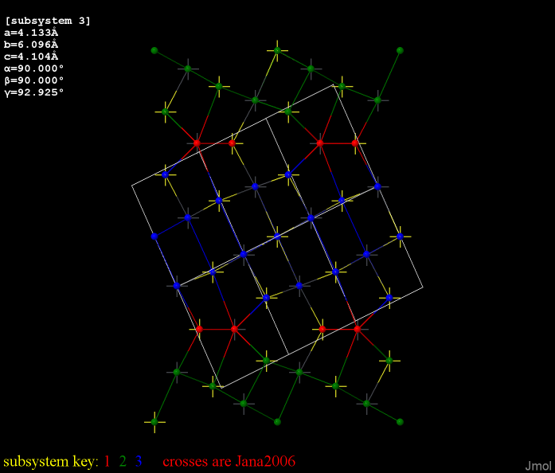
Crytallographic Capabilities of Jmol
Commensurate Subsystems

Slide 57
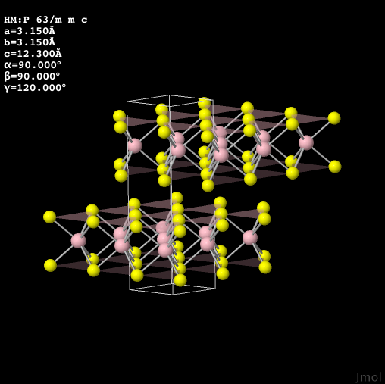
Crytallographic Capabilities of Jmol
CIF and Jana M40/50
file reading

Slide 58
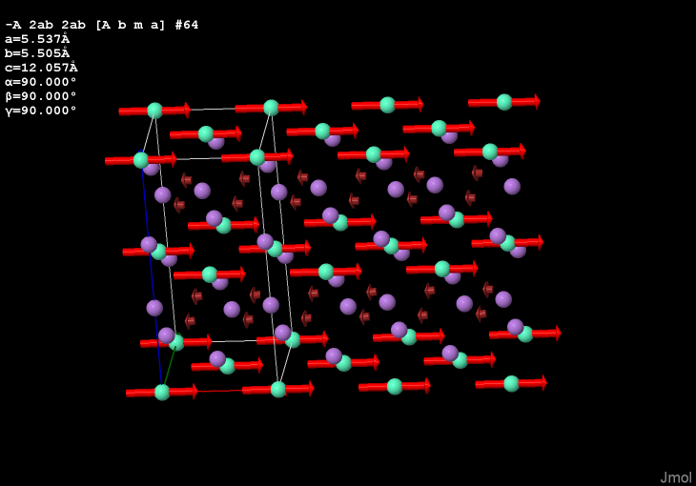
Crytallographic Capabilities of Jmol
mCIF (magnetic CIF) file reading with vector display

Slide 59
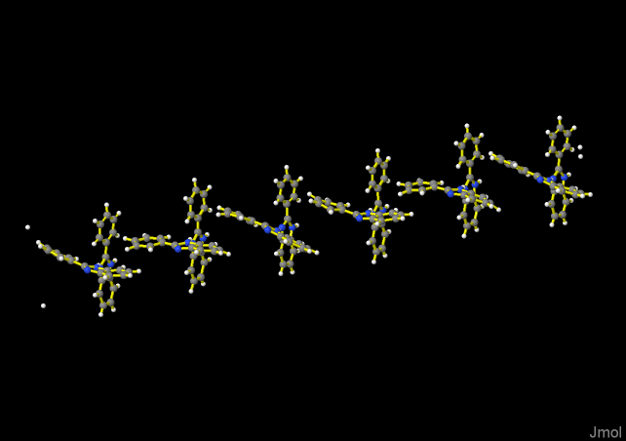
Crytallographic Capabilities of Jmol
Incommensurately modulated structures

Slide 60
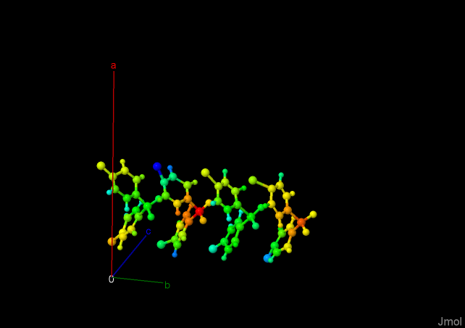
Crytallographic Capabilities of Jmol
Incommensurately modulated structures

Slide 61
Crytallographic Capabilities of Jmol
Incommensurately modulated structures

Slide 62
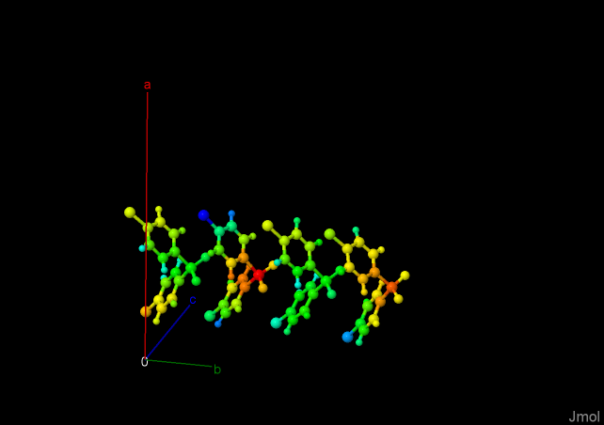
Development and Validation - displacement
2013.08.07

Slide 63

Development and Validation - displacement
2013.08.07

